Slide 1
GBAT Tutorial for Address Points
Gowri Anand

Slide 2
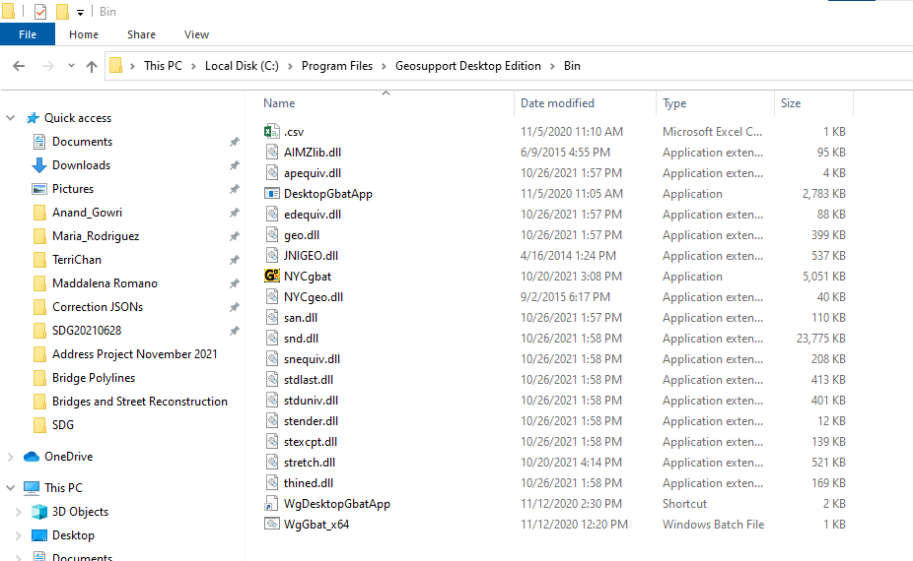
After installing the software successfully:
Go to “C:\Program Files\Geosupport Desktop Edition\Bin\NYCgbat.exe”

Slide 3
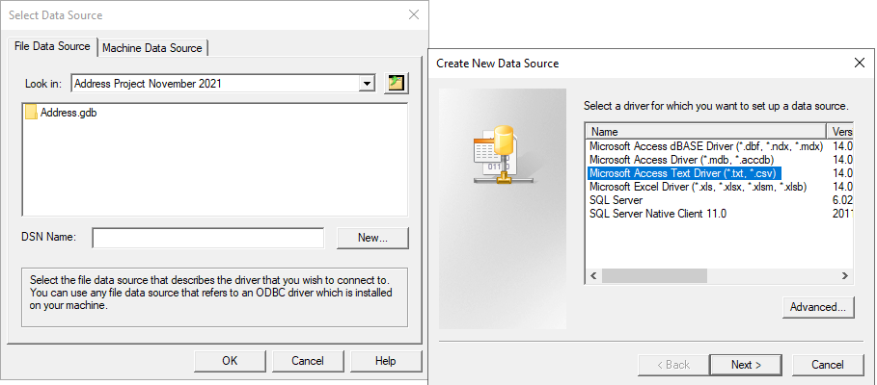
Once application opens
Click OK on the welcome window, then in the File Data Source tab, direct the pathway to where your file is located. Once it’s been directed, click New next to DSN Name and select Microsoft Access Text Driver and hit Next.

Slide 4
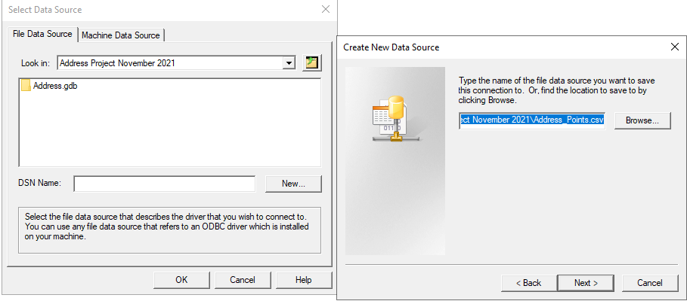
Create New Data Source File
To create a new data source file, find where the file is located and click on it. The image below shows what you should be left with.

Slide 5
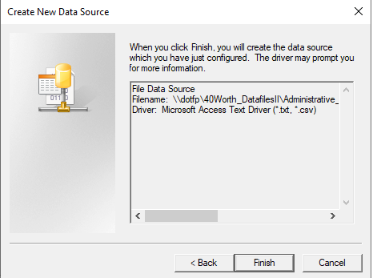
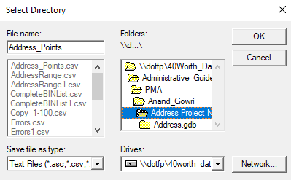
Create New Data Source File
Hit finish, which will then direct you to the Select Directory window. Once you have configured your directory and created a file name for it, hit the OK button.

Slide 6
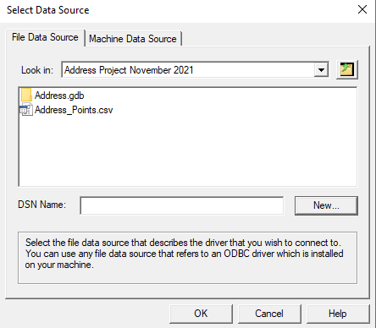
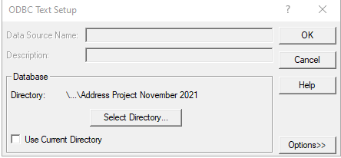
Create New Data Source File
Once you’ve completed the previous steps, the application should direct you to the ODBC Text Setup. Again, make sure the directory is correct and hit OK. Once this is complete, your output file should show like the image on the right.
Select the DSN file and hit OK

Slide 7
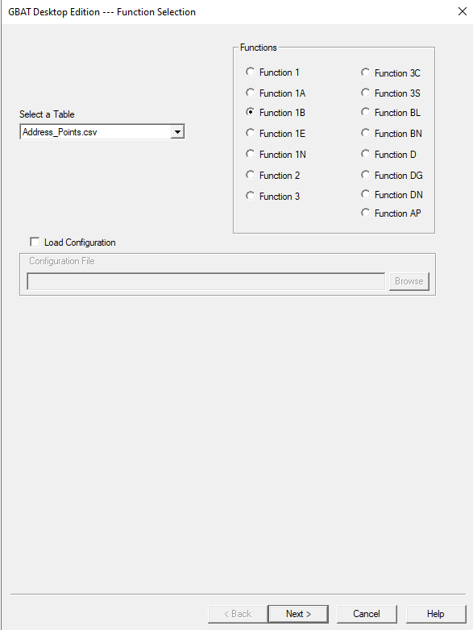
GBAT
This should direct you to the GBAT application
For the address file, you will want 1B.
If this isn’t your first time and you saved a configuration file, you can load the input configuration so you don’t have the manually repeat the steps each time.

Slide 8
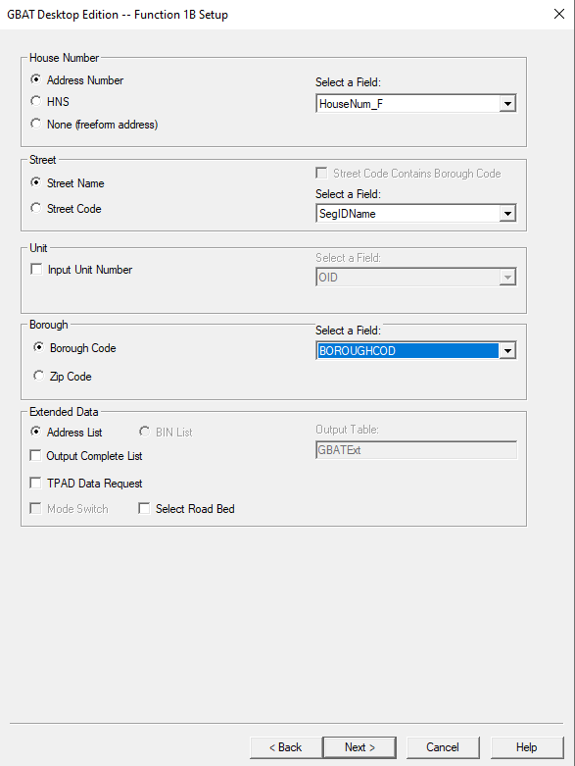
GBAT Input Configuration
For this particular file, this is the input configuration you will want.

Slide 9
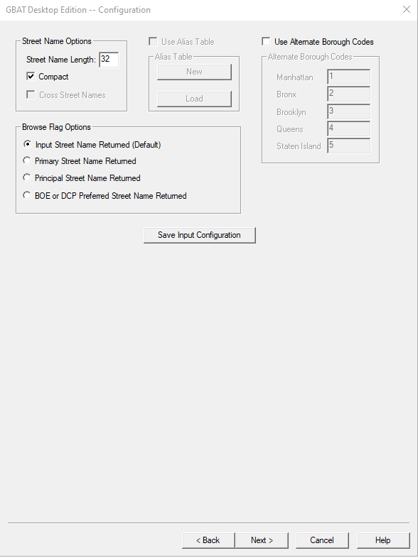
GBAT Input Configuration continued
Make sure you have the same options selected as the image on the right.
Save the input configuration so that you don’t have to repeat this part again.

Slide 10
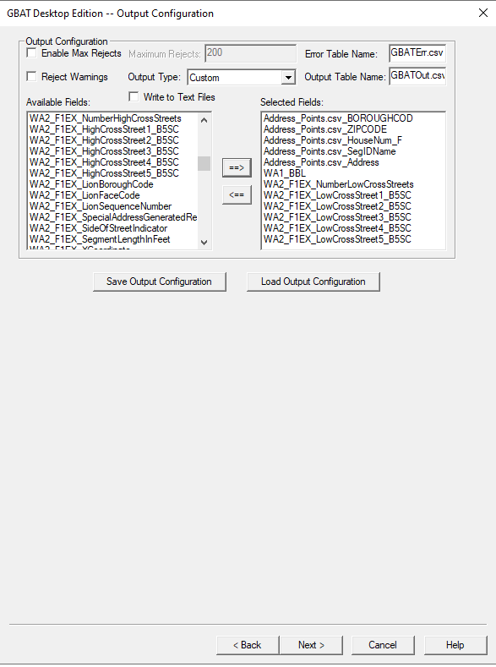
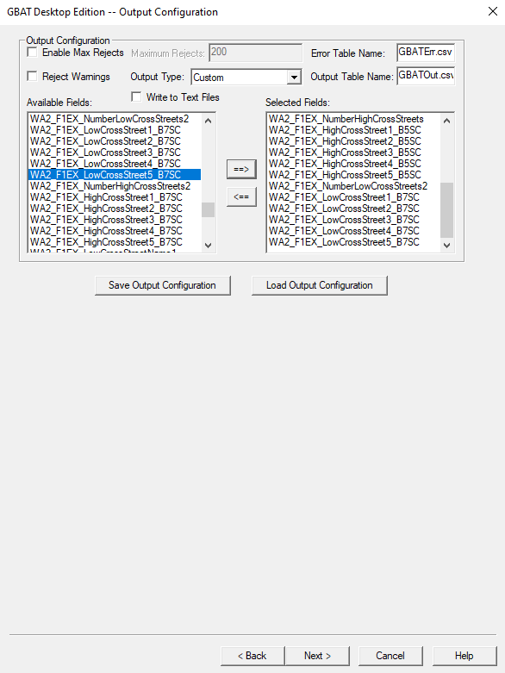
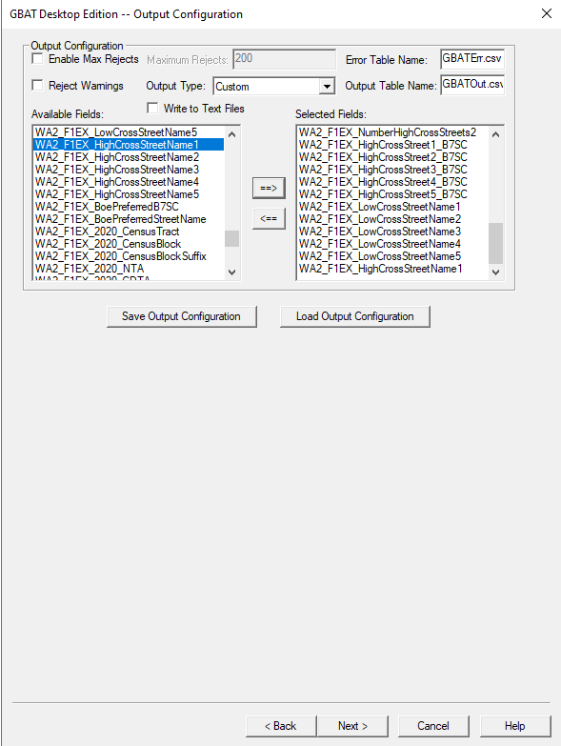
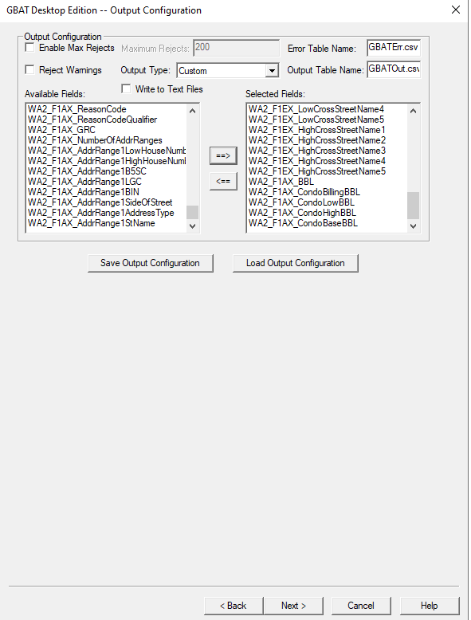
GBAT Output Configuration

Slide 11
GBAT Output Configuration
Once you have selected all the fields that you wanted, make sure to save the output configuration file so that you do not have to fill in all the columns you want every time.

Slide 12
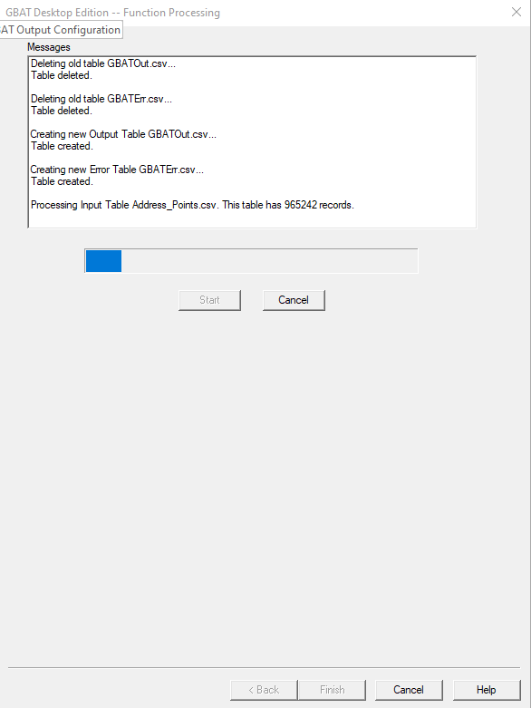
GBAT Output Configuration
Hit the start button to begin the function processing. Bar the first two messages, you should have the resulting window for your application.

